Slide 1


Introduction to
Robotic Process Automation
Hobby Engagement Bot
Your Register No: 220701233
Name: Rupala N
Guide Name: Dr. N. Durai Murugan
Designation and Department: Associate Professor, Department of Computer Science and Engineering

Slide 2
Abstract
The proposed project leverages UiPath's automation capabilities to create a personalized content delivery system tailored to user hobbies, specifically focusing on Reddit as the primary data source. This innovative solution automates the extraction of hobby-related information from Reddit and delivers it to users via email. By utilizing UiPath activities such as Data Scraping, For Each Row in Data Table, and Send SMTP Mail Message, the workflow processes user data efficiently, ensuring a seamless experience. The project begins by reading user information from an Excel file, including their hobbies and email addresses. For each user, the workflow dynamically searches Reddit for relevant discussions and extracts key insights related to their hobbies. The extracted data is formatted into a structured and personalized email, making it both informative and engaging. While the current implementation focuses solely on Reddit, the solution is designed with scalability in mind. .

Slide 3
Need for the Proposed System
In the age of digital transformation, automation is playing a pivotal role in reshaping how individuals and businesses interact with information.
One area where automation can be particularly impactful is in personalized content aggregation. People often spend hours searching for relevant information online about their hobbies, interests, or passions.
This project aims to address this challenge by leveraging UiPath’s capabilities to develop a solution that automates the discovery and delivery of hobby-specific content, focusing on Reddit as the initial data source.

Slide 4
Advantages of the Proposed System
The proposed system introduces an automated solution using UiPath to streamline content aggregation and delivery for hobby enthusiasts.
By leveraging Reddit as the primary platform, the bot dynamically processes user inputs, such as hobbies, from an Excel sheet and scrapes relevant data from corresponding Reddit threads.
This includes trending posts, discussions, or updates tailored to each user's interests. The scraped data is formatted into a concise, user-friendly summary and sent via email.
Additionally, the proposed system lays the foundation for future enhancements, such as integrating more platforms like Amazon or dedicated forums, incorporating sentiment analysis to prioritize impactful content, and expanding notification channels beyond email.

Slide 5
Literature Survey
RPA has emerged as a transformative technology for automating repetitive tasks, including data collection, extraction, and processing. Studies by Willcocks et al. (2015) highlight RPA's ability to emulate human interactions with digital systems, thereby increasing efficiency and reducing errors in data-driven workflows.
Web scraping is a widely used technique to extract structured information from unstructured web data. Research by Aghajarian et al. (2018) emphasizes its utility in aggregating content from forums, e-commerce platforms, and social media sites.

Slide 6
Main Objective
The primary objective of this project is to develop an automated solution using UiPath that simplifies personalized hobby related content aggregation for users. By leveraging Reddit as the primary data source, the project aims to extract relevant hobby-specific information and deliver it directly to users via email. The workflow is designed to dynamically process user inputs, such as hobbies, and scrape data from corresponding Reddit threads, ensuring personalized and meaningful results. This project emphasizes the practical application of RPA concepts like data scraping, control flow, and email automation, while laying the foundation for future scalability to integrate multiple platforms.

Slide 7
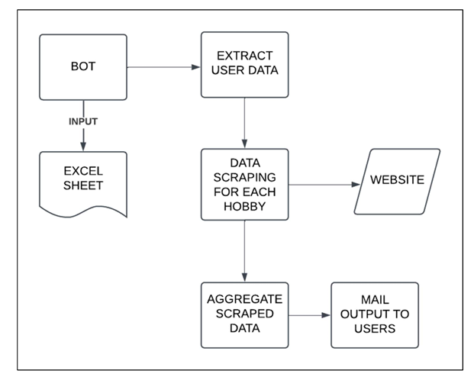
Architecture
Architecture Diagram of the system

Slide 8
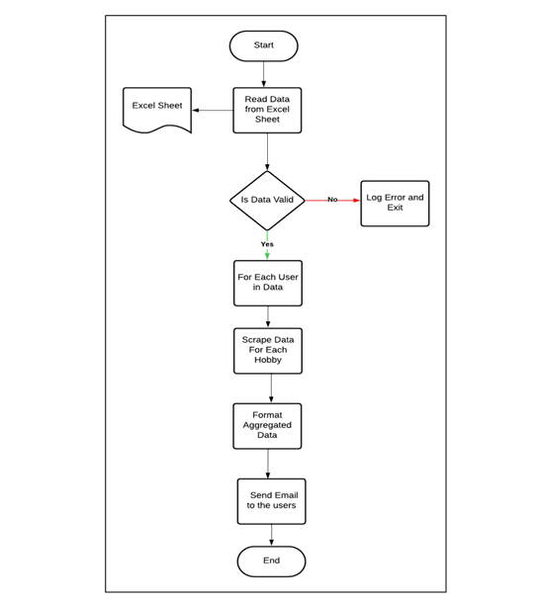
System Flow Diagram: FlowChart

Slide 9
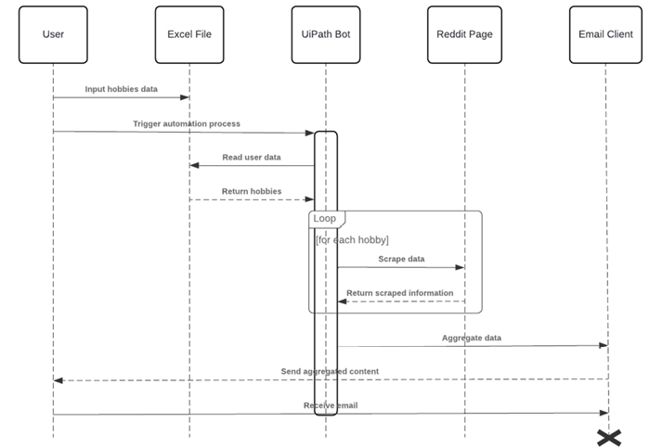
Data Flow Diagram – Sequence Diagram

Slide 10
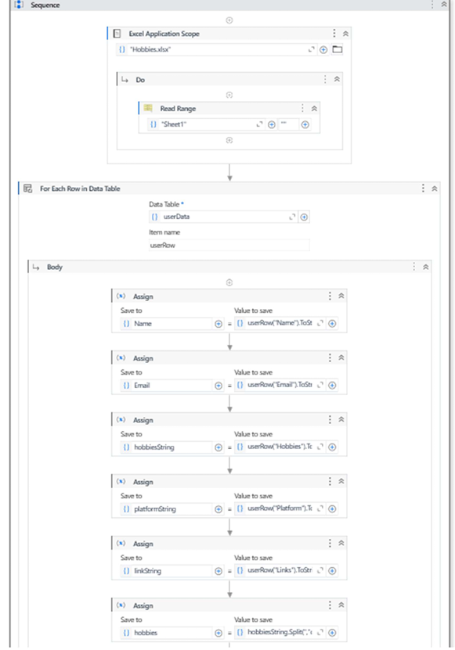
Implementation

Slide 11
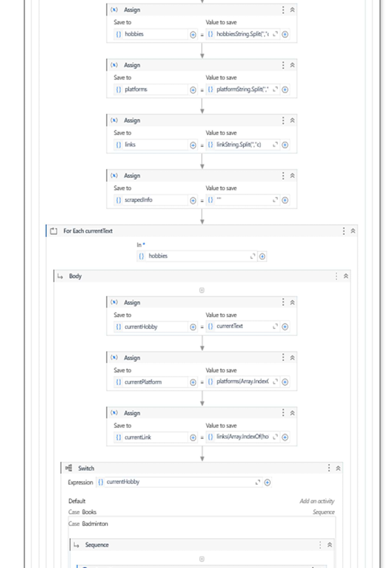
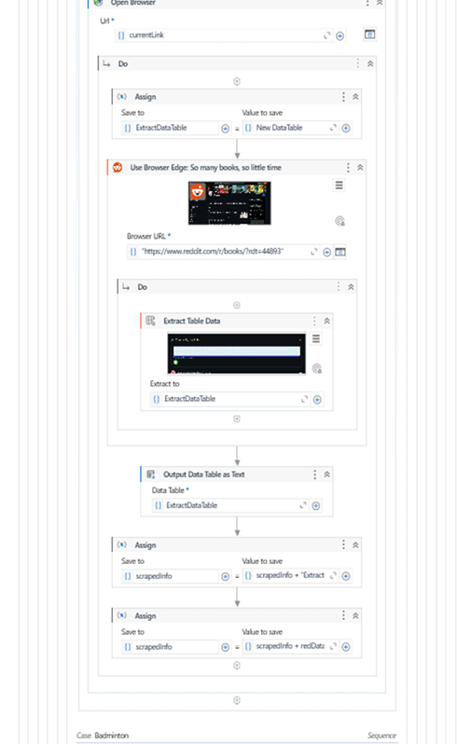
Implementation

Slide 12
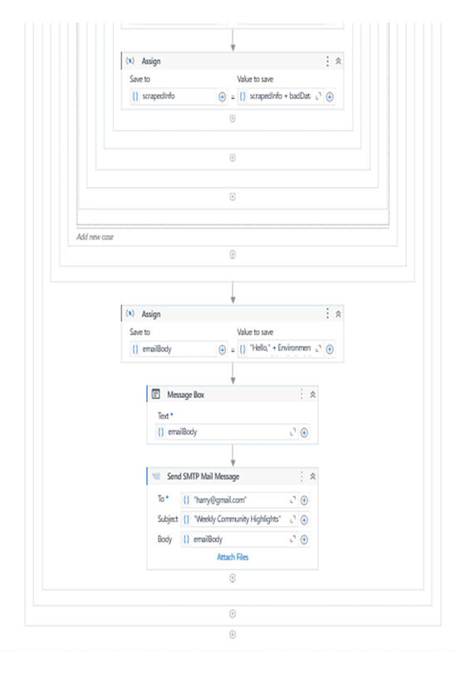
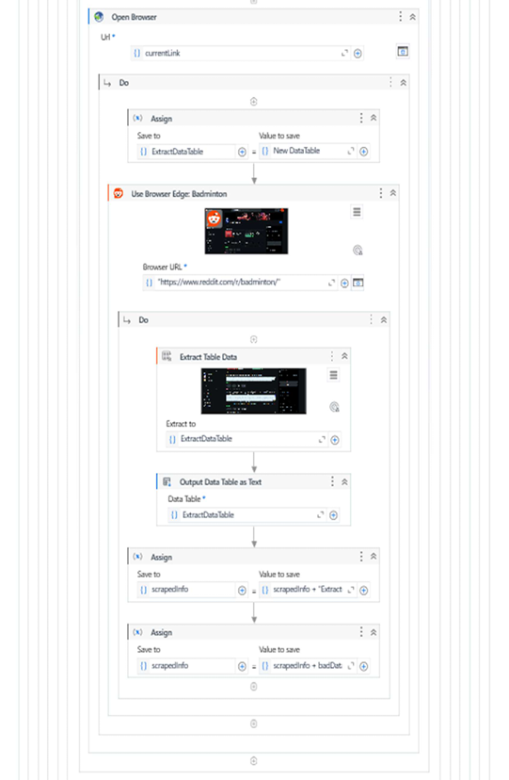
Implementation

Slide 13
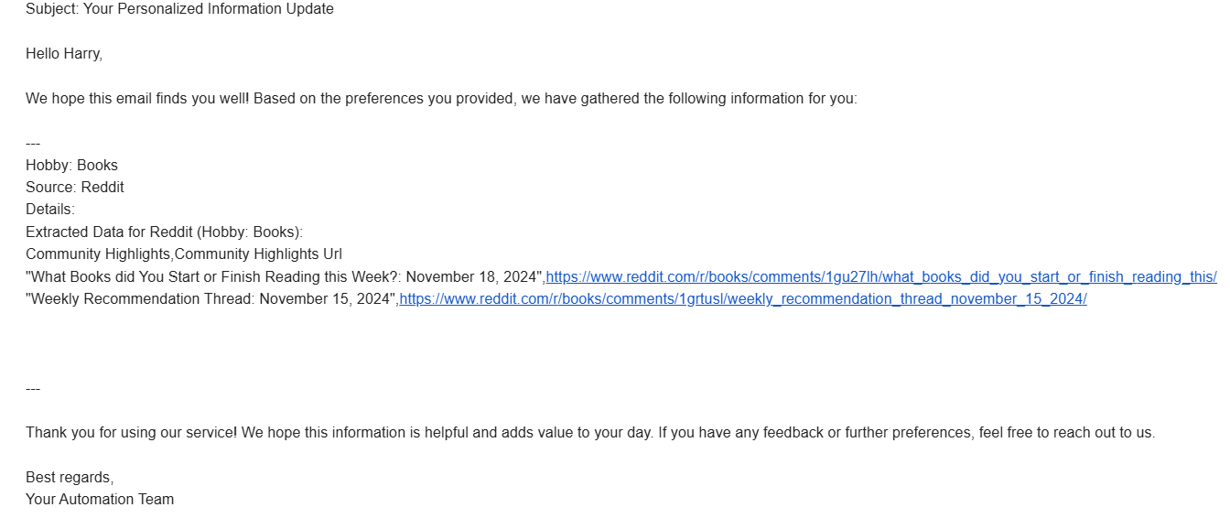
Sample Output:

Slide 14
Conclusions
The Automated Hobby-Based Reddit Data Aggregator exemplifies the transformative potential of Robotic Process Automation (RPA) in simplifying complex workflows and providing personalized user experiences. By leveraging UiPath’s robust capabilities, this project streamlines the process of hobby-specific data collection and aggregation, addressing the growing need for customized insights in a digital age.
This system efficiently reads user data, including hobbies and links, from an Excel file and processes it to fetch relevant content from Reddit. By automating the data extraction, aggregation, and communication steps, the project not only reduces manual effort but also ensures a consistent and error-free workflow.

Slide 15
Future Enhancement
The project paves the way for future enhancements, such as integrating multiple platforms and utilizing techniques for content summarization. By addressing the identified challenges and leveraging advancements in RPA and personalization technologies, this project demonstrates the potential of automation in delivering value to end-users.
Looking ahead, the system could be extended to include multi-lingual support and sentiment analysis for a broader scope of user engagement. These advancements would enable the system to cater to global audiences and extract insights with deeper contextual relevance.

Slide 16
References
UiPath Documentation: Email Activities Guide
○ This documentation offered detailed instructions on configuring and using UiPath’s email activities, such as fetching emails via IMAP and dispatching them via SMTP.
OpenAI API Documentation: ChatGPT API Usage and Features
○ The OpenAI API documentation served as a key reference for understanding the capabilities of the GPT models, including text generation, response customization, and handling API requests.

Slide 17
Thank You

